Slide 1

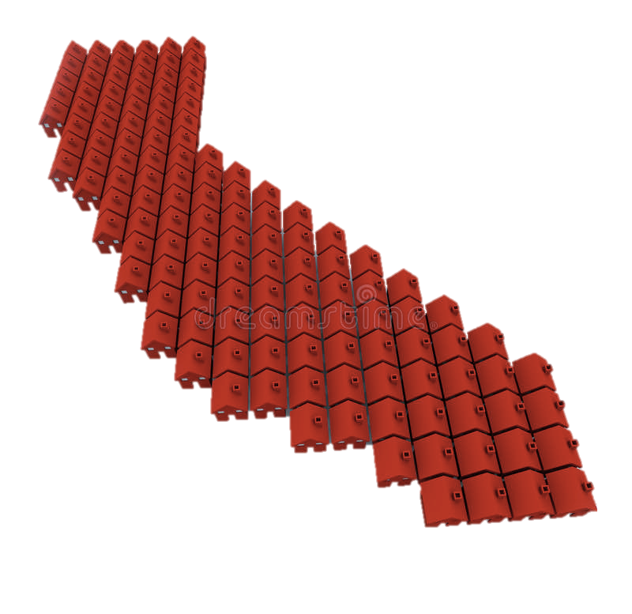

California Housing Market Application
Group: Data Works
Nupur Pathak
Revathi Boopathi
Sree Divya Cheerla
Vani Bhat

Slide 2

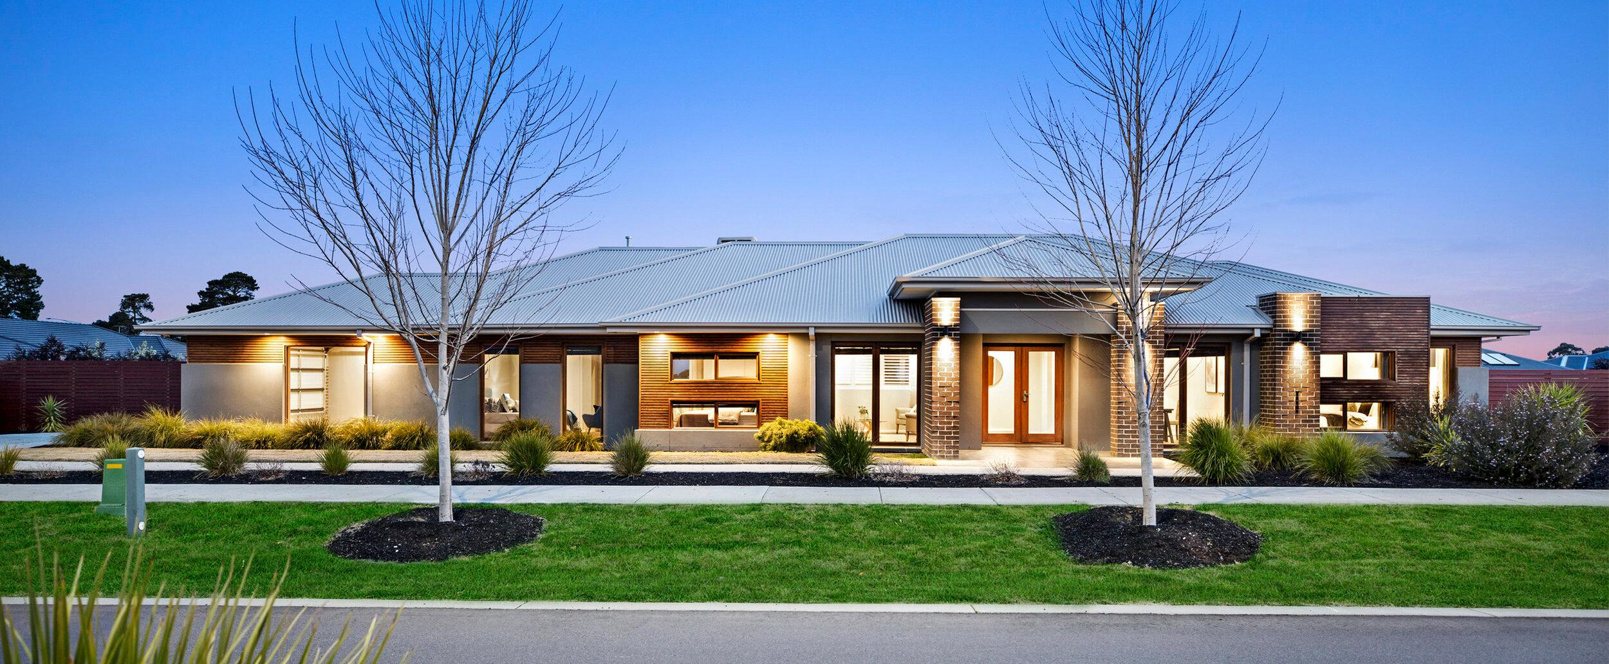




Agenda
Introduction
Project Goals and Objective
Problem and Motivation
System Design
Architecture Design
Date Collection
Data Model
System Implementation
Setup AWS resources
Data Storage
Extract, Transform, and Load (ETL)
Modeling
Analytics and Visualization
Conclusion and Future Work

Slide 3

Introduction
Project Goals and Objective
Problem and Motivation

Slide 4


Project Goals and Objectives
Build California housing market application to ease the process of housing property search for the customers based on their preferred buying criteria
Influence on house/property values by the presence of public schools with higher ranking in the region

Slide 5





Problem and Motivation
The surge in demand for the US housing market and shortage of inventory has made it difficult for people to find their dream home with all the features they desire with ease. Hybrid work culture resulting from the pandemic is fueling the demand in the housing market.
There are various parameters that are impacting property values such as:
School proximity
Migration of people impacting the population density
Crime rate
Job opportunities
New construction
Recreational centers
Medical care facilities
Access to public transportation, and others

Slide 6
System Design
Architecture Design
Data Collection
Data Model

Slide 7



















Architecture Design
Tableau Desktop
Authenticated using Amazon Athena JDBC Driver
IAM Policy
SageMaker End Point
SageMaker Linear Learner
Simple Storage Service (S3)
IAM Policy
CloudFormation Stack
SageMaker Notebook
Simple Storage Service (S3)
Glue Crawler
Glue Data Catalog
Glue Notebook/Editor
Athena

Slide 8




Data Collection: Housing Data + School Ranking
Housing Data:
Data on the house listings is collected with the help of web scraper
The data is scraped for cities in California iterating listings on each page for the search results
Listings sourced from the site are collated in Jupyter notebook
School Ranking Data:
California Charter Schools Association provides the rating for public and private schools in California
The school state-wide rankings are sourced from CCSA for 2019. Each school is ranked on a scale of 10.

Slide 9
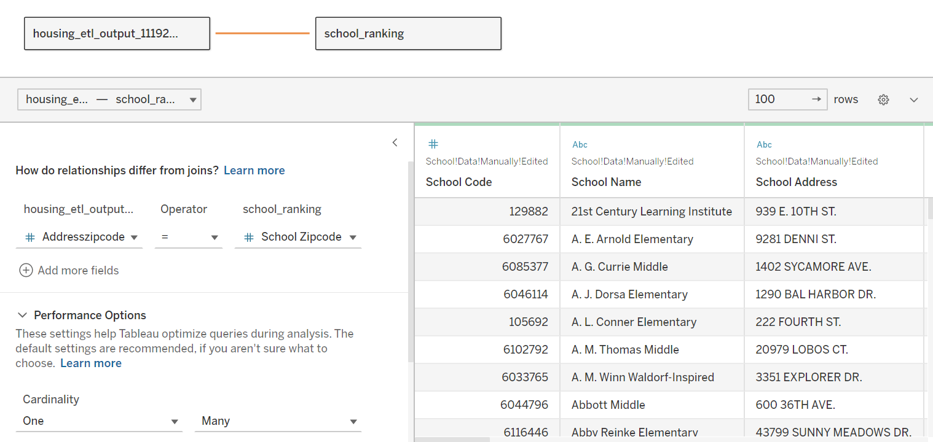
Data Model
housing_etl_output
zpid
imgsrc
hasimage
detailurl
statustext
price
unformattedprice
address
addressstreet
addresscity
addressstate
addresszipcode
bed
bath
areacode
hasopenhouse
openhousedescription
Estimated yearly cost
has3dmodel
hasadditionalattributions
brokername
homeinfo_latitude
homeinfo_longitude
homeinfo_hometype
homeinfo_lotareavalue
homeinfo_lotareaunit
Avg School Rank
Sum School Enrollment
school_ranking
school_code
school_name
school_address
school_city
school_state
school_zipcode
school_areacode
school_latitude
school_longitude
school_type
ENROLLMENT
ST_GRADE
END_GRADE
FT_TEACHER
statewide_rank
similar_students_rank
college_career_percent_prepared
school_county
school_district
Authorizer
Statewide_Percentile

Slide 10
System Implementation
Setup AWS resources
Data Storage
Data Transformation (ETL)
Modeling
Analytics and Visualization

Slide 11
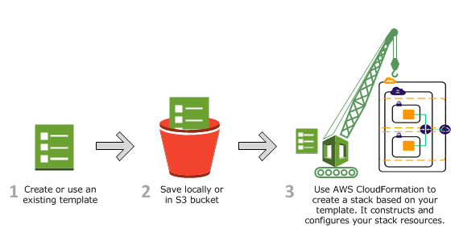
Setup AWS resources: AWS Cloud Formation
Automate resource creation for AWS GLUE

Slide 12
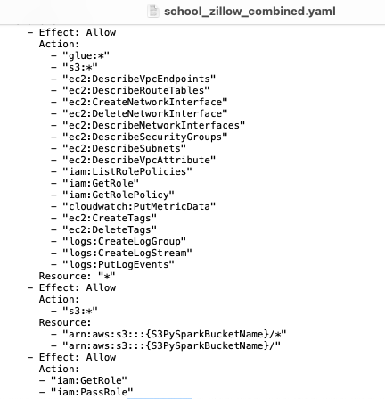
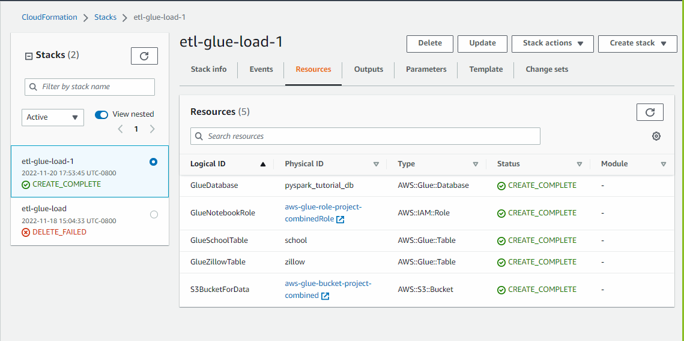
Setup AWS resources: AWS Cloud Formation
.yaml file to configure the resources
Loads database, IAM roles, data tables with schema, S3 bucket

Slide 13
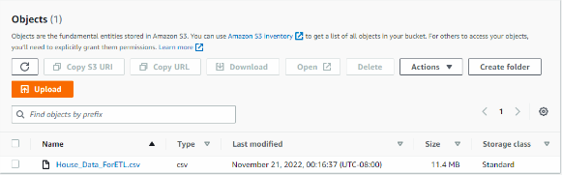
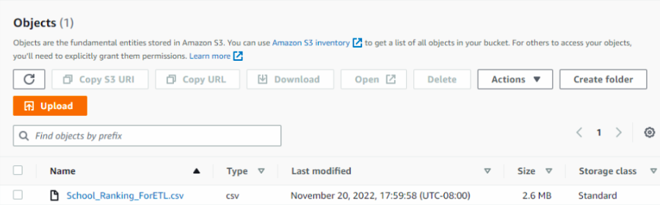

Data Storage: AWS S3
Add school and house data into S3 bucket
House Data
School Data
aws-glue-bucket-project-combined

Slide 14
Data Transformation (ETL): AWS GLUE
AWS GLUE visual editor flow to transform the datasets and load to data target S3
AWS GLUE Data Catalog
(House Data)
Change Schema
(Apply Mapping)
Drop Duplicates
Filter Data
Custom SQL Query
LEFT Join on zip
Fill Missing Values
Data Target:S3
AWS GLUE Data Catalog
(School Data)
Change Schema
(Apply Mapping)
Drop Duplicates
Filter Data
Aggregate
Data Target:S3

Slide 15
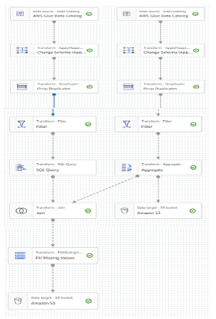
Data Transformation (ETL): AWS GLUE Visual Editor Flow Diagram
Transforming data from AWS GLUE Data Catalogue using AWS Glue’s ETL Job

Slide 16
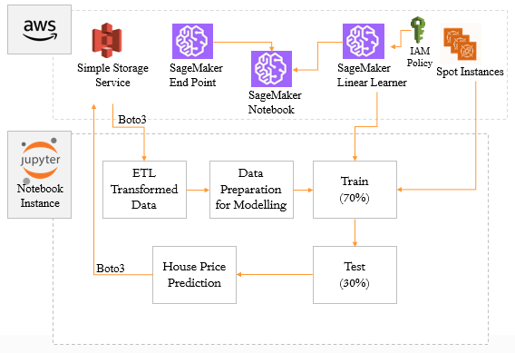
Modeling: SageMaker Architecture and Process Flow

Slide 17
Modeling: Model Features and Evaluation metrics
Features
Bed | Bath | Additional Attributes | Home type | Price per square feet | Avg School Rank | School Enrollment | Estimated Yearly cost | Home price
2 | 1 | False | Townhouse | $ 687 | 8.9 | 600 | 750 k | 980 k
3 | 1 | True | Single Family | $ 300 | 6 | 300 | 380 k | 1.1 M
1 | 1 | True | Condo | $ 200 | 2.3 | 250 | 250 k | 200 k
… | … | … | … | … | … | … | … | …
Evaluation
R2 – 0.6
Adjusted R2 – 0.59
Explained Variance Score – 0.6

Slide 18
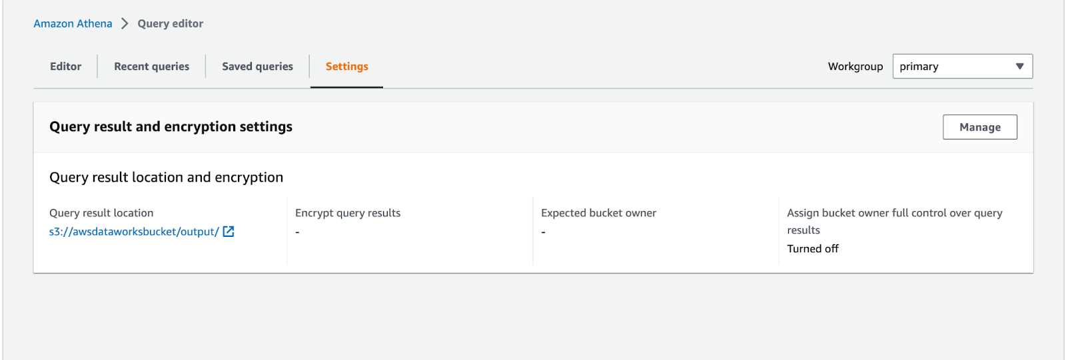
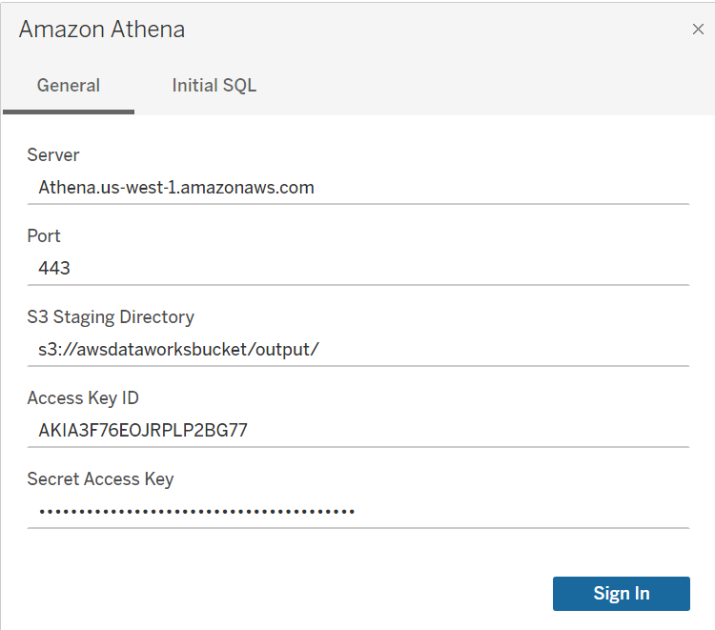
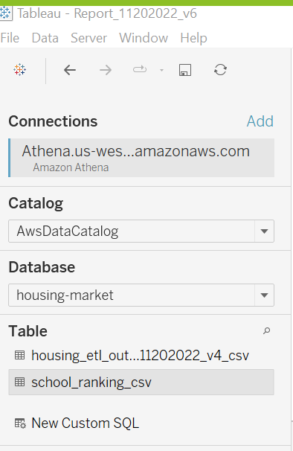
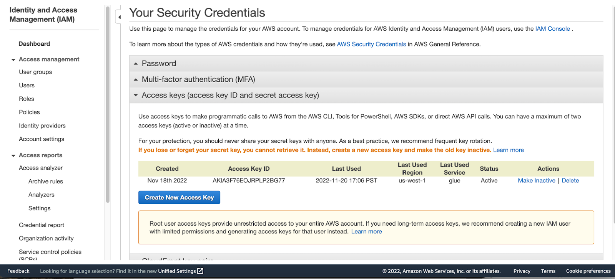
Analytics and Visualization: Amazon Athena to Tableau Dashboard

Slide 19
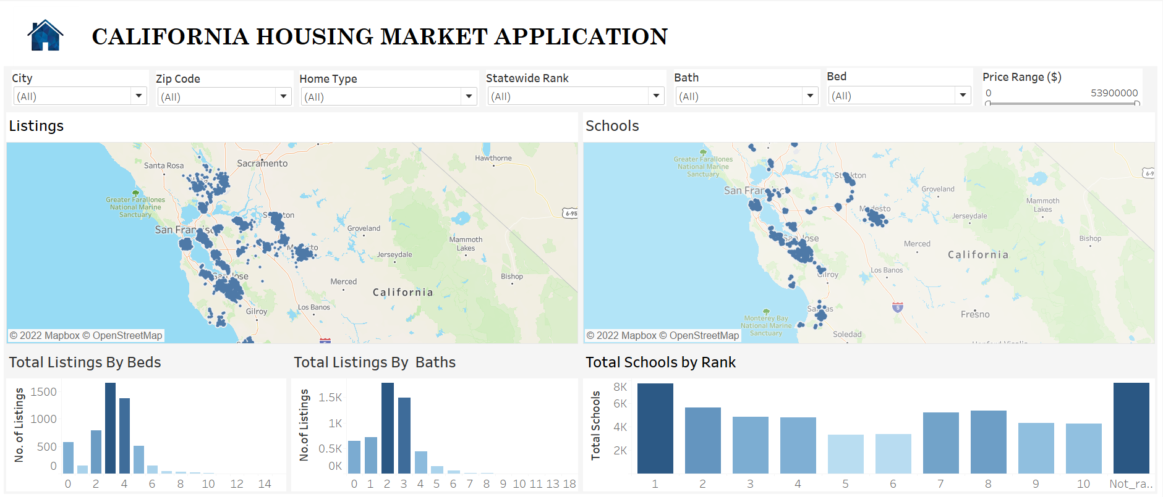
Dashboard: Home Page

Slide 20
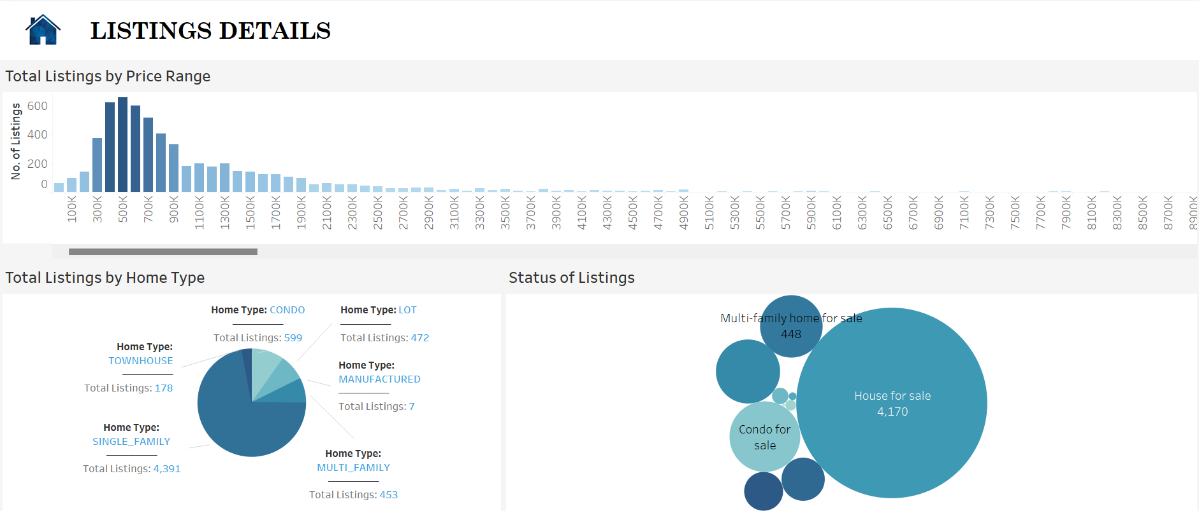
Dashboard: Listings Details

Slide 21
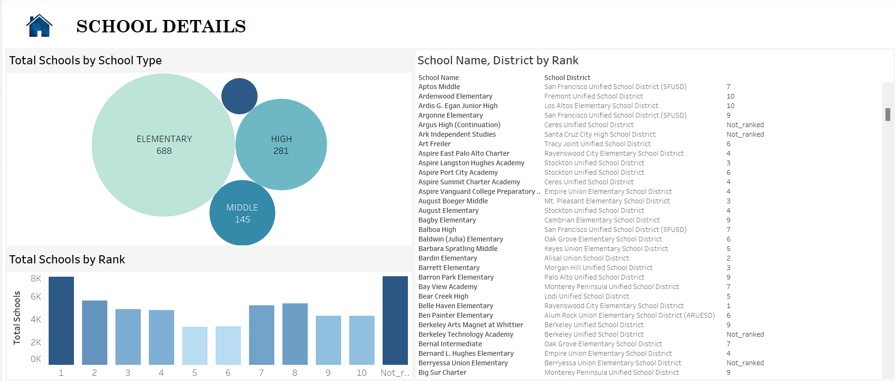
Dashboard: School Details

Slide 22

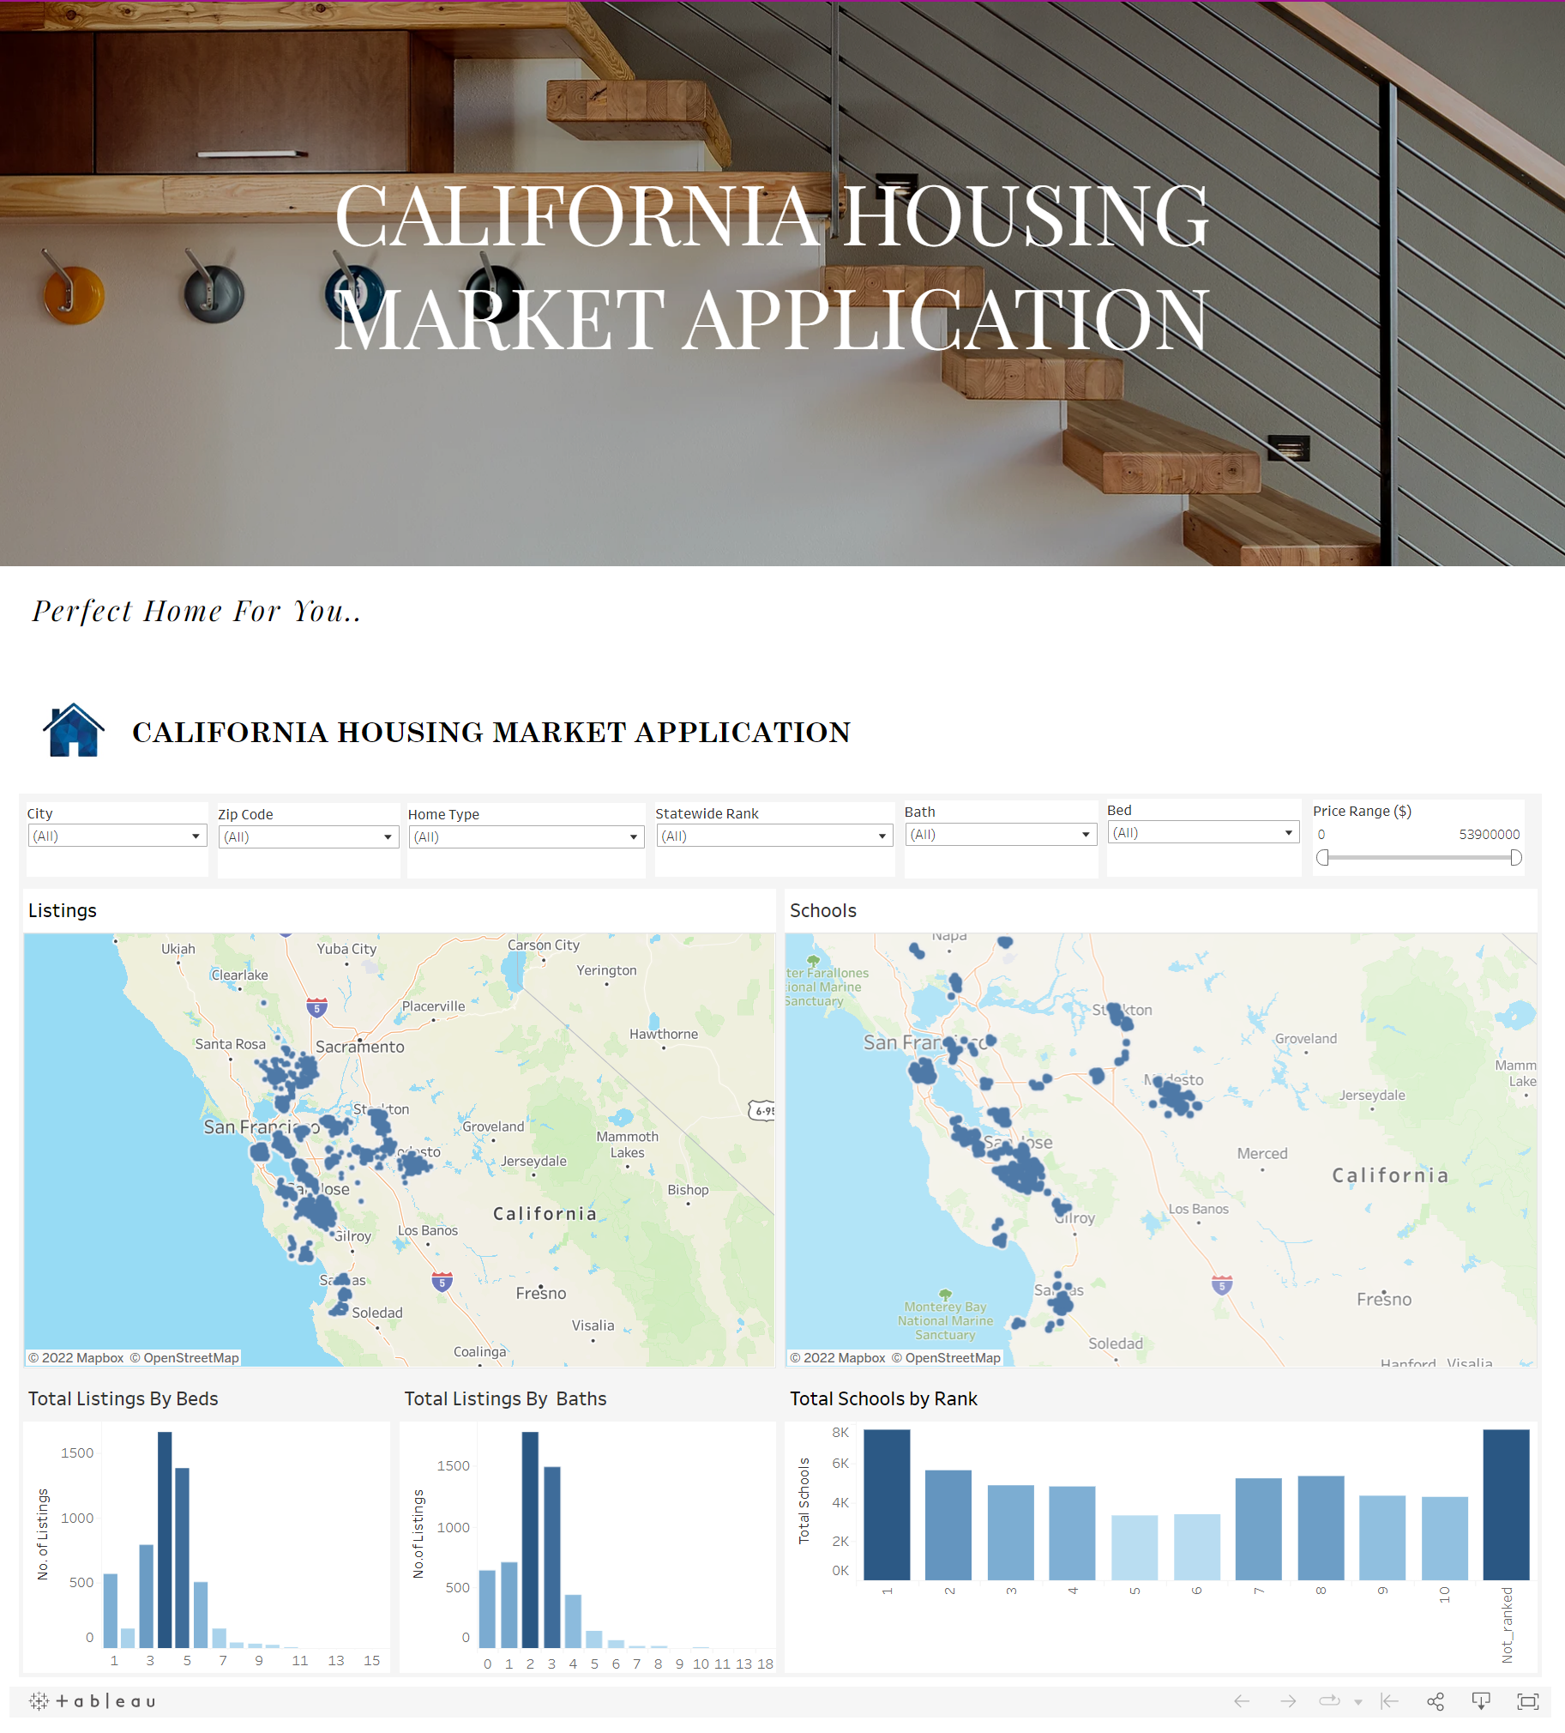
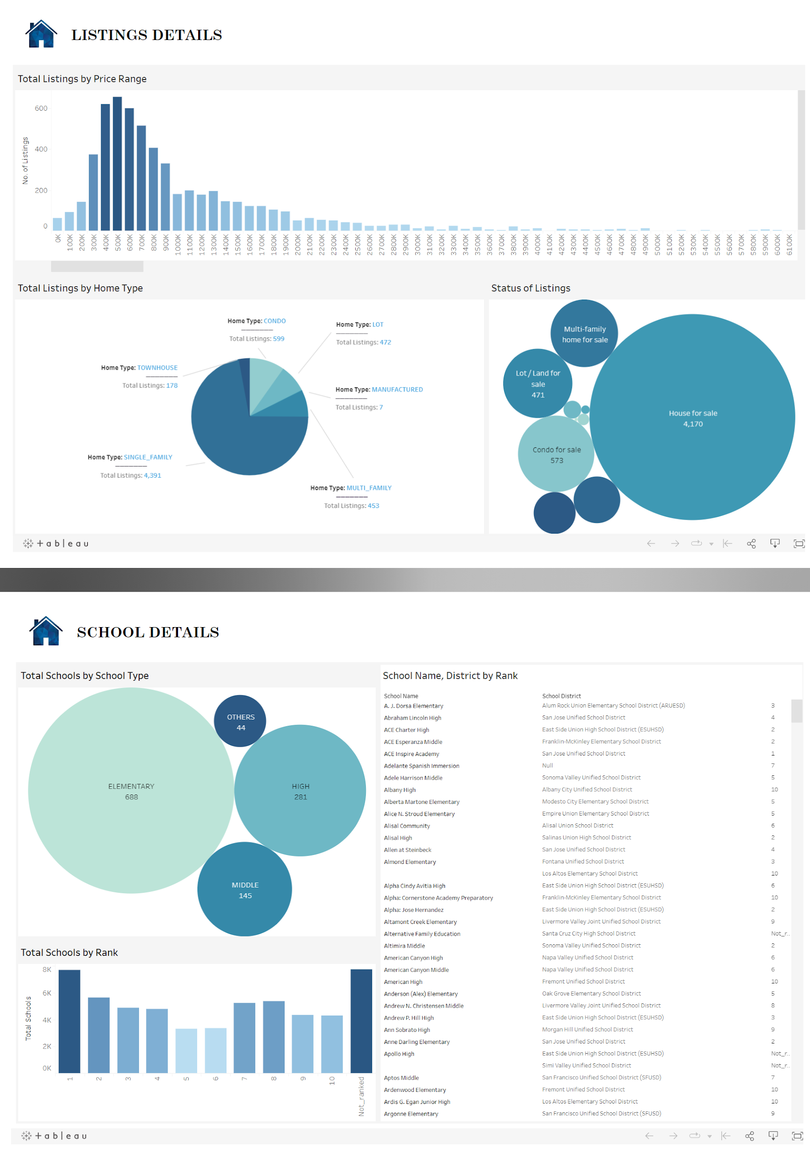
California Housing Market Application Site
Website Link

Slide 23
Conclusion and Future Work

Slide 24
Conclusion and Future Work
Overall,
Built a scalable ‘California Housing Market’ big data application leveraging various services in AWS cloud platform.
It serves as a search platform for the home buyers to view the properties, get the best price quote and insights about house price variation due to the presence of schools
As a future work,
The application can be improvised to use AWS Kinesis to live capture the data and analytics
Event triggering through AWS Lambda to connect various AWS componet’s and data pipeline for continuous deployment and execution in a single click

Slide 25
References
https://www.dreamstime.com/illustration/california-houses.html
https://templates.office.com/en-us/presentations
https://homeshots.us/
https://www.ccsa.org/what-we-do/student-success
https://www.zillow.com/homes/for_sale/
https://www.tableau.com/
https://public.tableau.com/app/discover
https://www.zillow.com/https://jupyter.org/
https://www.wix.com/
https://www.dreamstime.com/illustration/california-houses.html
https://templates.office.com/en-us/presentations
https://homeshots.us/
https://docs.aws.amazon.com/AWSCloudFormation/latest/UserGuide/cfn-whatis-howdoesitwork.html

Slide 26

Team

Slide 27

Thank You

